Slide 1
Water Pollution sensing using Automatic boat
Group 2 (CS724)

Slide 2
Agenda
01
02
03
04
05
06
Problem Statement
Lawnmower algorithm
Hardware Configuration
Demo Video
Goals Achieved
Project Snaps

Slide 3
01
Problem Statement

Slide 4
Introduction
Problem Statement
Solution
Clean water is the lifeblood of our ecosystem, the vast expanses of our planet's lakes, reservoirs, and canals serve as vital sources of drinking water.
However, the maintenance of these water bodies' purity is a growing concern due to various anthropogenic activities leading to pollution.
Traditional monitoring methods can be labor-intensive, inconsistent, and unable to provide real-time feedback.
Addressing this imperative need, we introduce an innovative solution: the Fully Automated Water Pollution Monitor Boat.
This self-navigating boat, armed with the computational power of a Raspberry Pi board and equipped with pollution detection sensors, promises a paradigm shift in how we perceive and act upon water quality monitoring.

Slide 5
02
Hardware Configuration

Slide 6
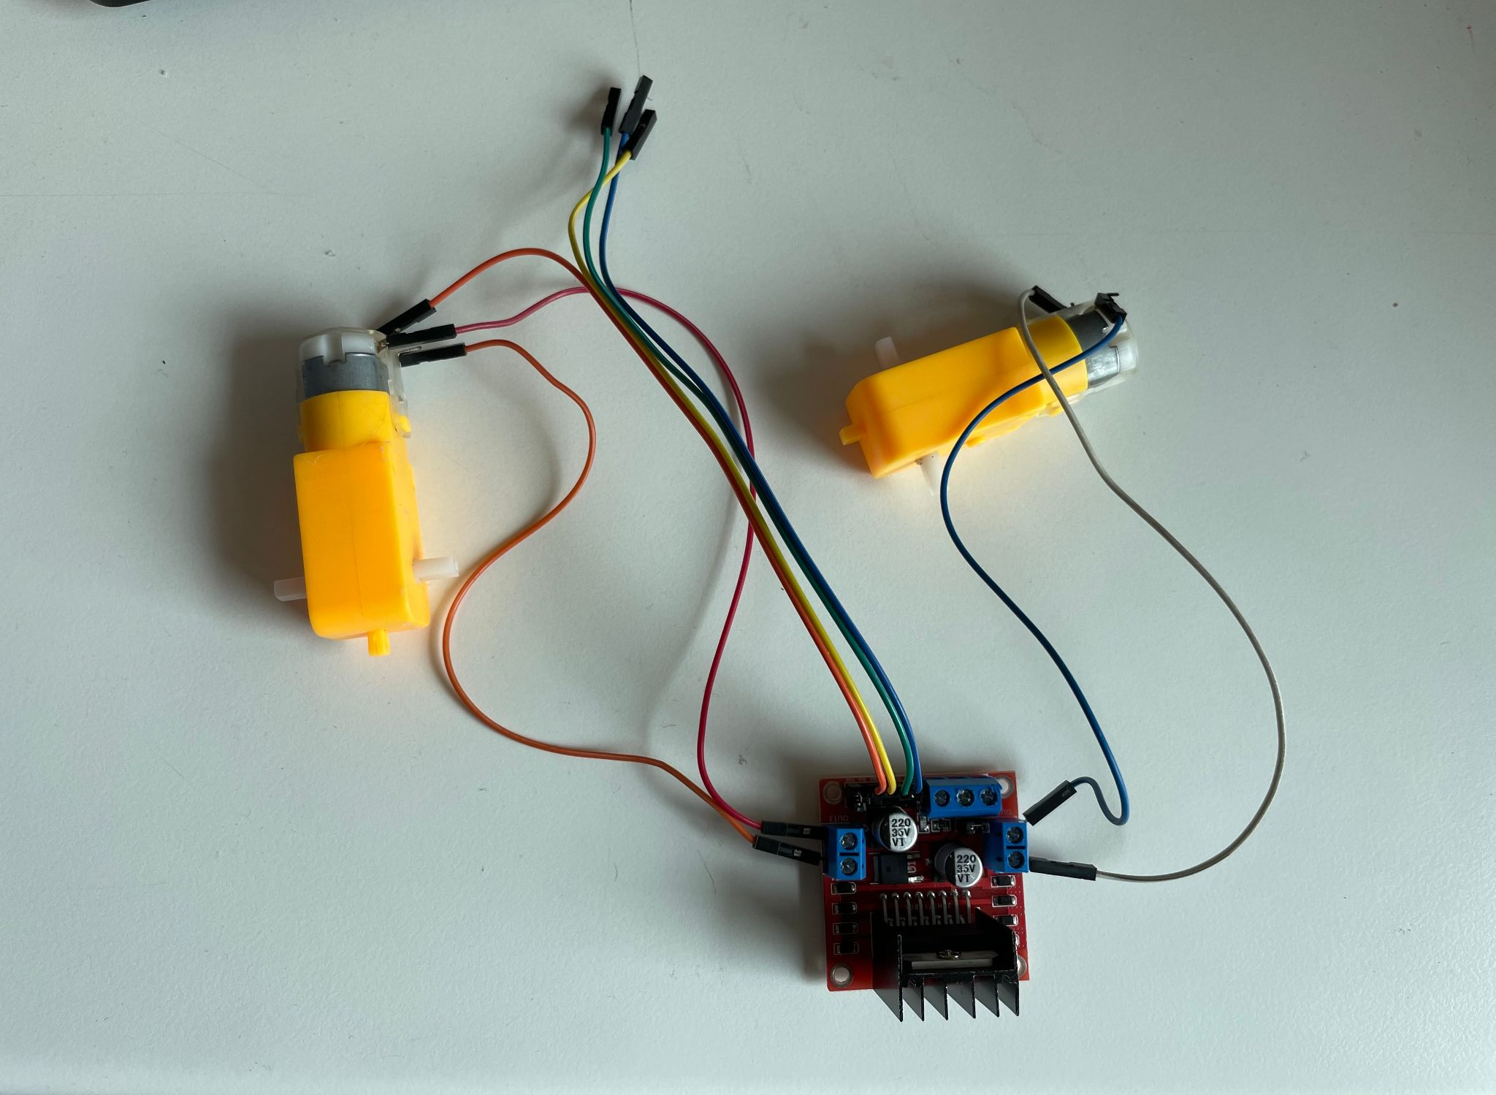
Raspberry Pi and L298n configuration
Raspberry Pi Pins | L298n Pins
GPIO 5 | IN1
GPIO 6 | IN2
GPIO 18 | IN3
GPIO 27 | IN4
GPIO 4 | ENA
GPIO 13 | ENB

Slide 7
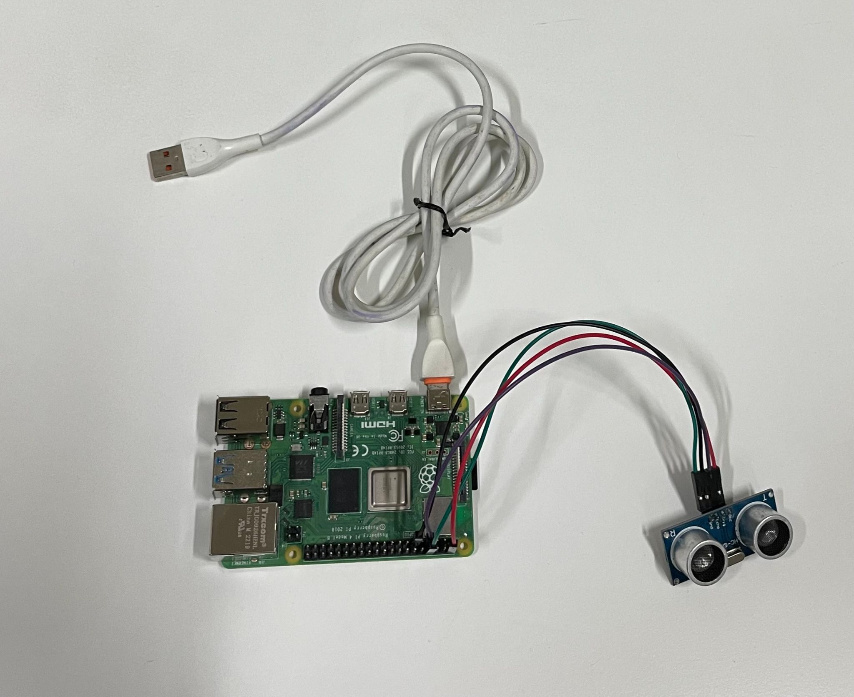
Raspberry Pi and Ultrasonic sensor configuration
Raspberry Pi Pins | Device Pins
GPIO 4 | Trigger
GPIO 17 | Echo
4 | VCC
8 | GND

Slide 8
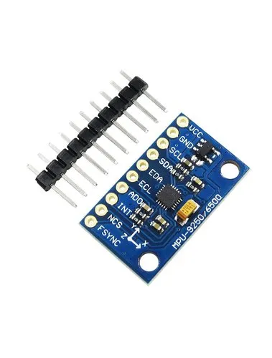
IMU Sensor
An inertial measurement unit (IMU) is an electronic device that measures and reports a body's specific force, angular rate, and sometimes the orientation of the body, using a combination of accelerometers, gyroscopes, and sometimes magnetometers. When the magnetometer is included, IMUs are referred to as IMMUs.
IMU provides a 3-axis sensor, that is, accelerometer, gyroscope, and magnetometer. These sensor data is used to calculate the position of the target in an indoor environment.
IMU relies on accelerometers and gyroscopes to measure changes in velocity and angular rate for real-time positioning whereas utilizes signals from satellites to provide global positioning information.
IMU offers high-frequency data but tends to suffer from drift over time; suitable for applications like drones and robotics whereas provides accurate global positioning but may be affected by signal blockage; widely used for outdoor navigation and mapping.
SDA: pin3(GPIO2)
SCL: pin5(GPIO3)

Slide 9
03
Lawnmower Algorithm

Slide 10
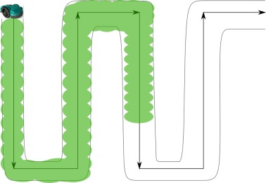
Basic Algorithm:
Initialization
Avoiding
Obstacles
Continuously monitor the ultrasonic sensor for distance measurements.
If an obstacle is detected (distance reading falls below a predefined threshold)
Stop both motors to halt the boat.
Determine the direction of the obstacle (left, right, or front).
Depending on the obstacles direction, turn the boat left or right by adjusting the motor speeds.
Once clear from the obstacle, reorient the boat towards the next waypoint.

Slide 11
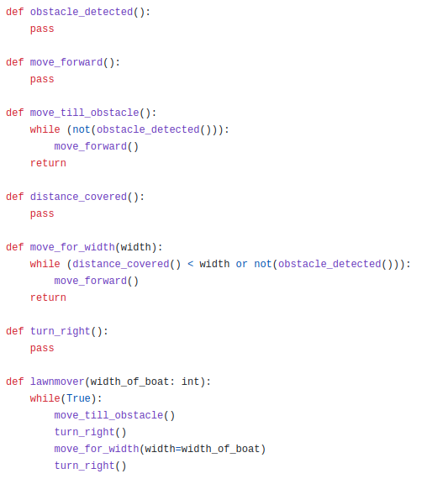
First Attempt Algorithm:
This was the first attempt algorithm that we designed for the “Lawn mower path” movement.
It uses the Ultrasonic sensor to detect the distance from obstacles and move accordingly.
We have tested this in lab environment and it works as expected.
Next step, would be to test in the real environment.
We further modified it to the final algorithm after carrying out various tests in the real-life scenario.

Slide 12
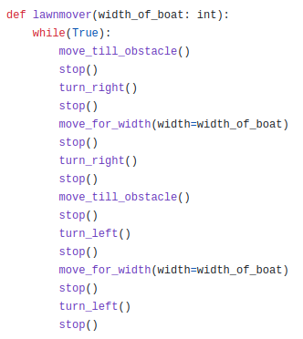
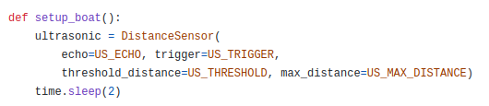
Final Lawnmower Algorithm:
We updated the first attempt algorithm to inculcate the data from ultrasonic sensor for object detection.
We also modified it to work better on lawnmower motion.
The exact working is displayed in the images attached.

Slide 13
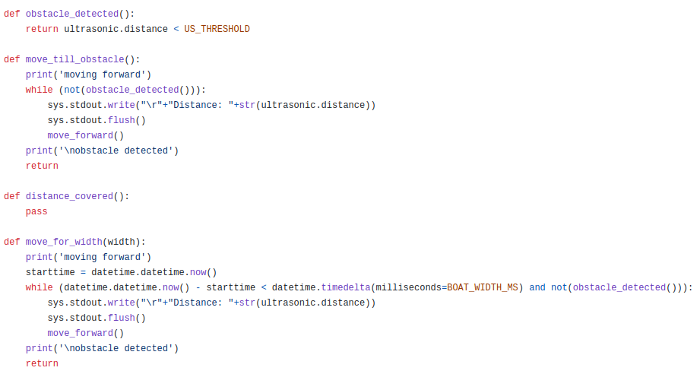
Final Lawnmower Algorithm:

Slide 14
04
Project Snaps

Slide 15
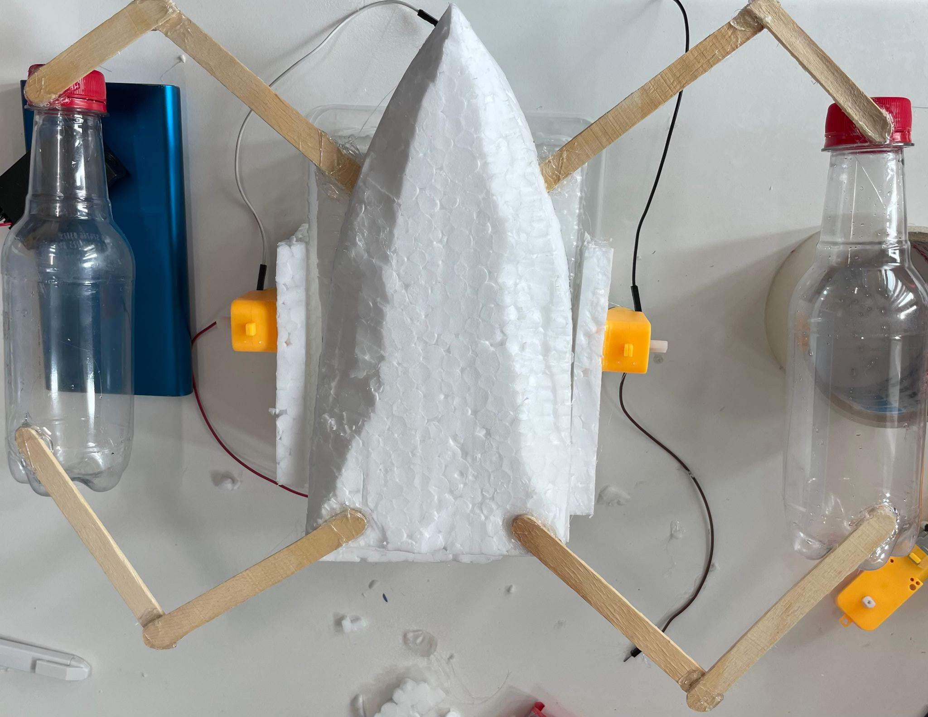
Boat Structure
This is the upside down view of the boat structure that we attempted at first.
It did not work well in real-life scenario due to it’s bulkiness.
The presence of bottles which we assumed would make the boat float instead increased it’s weight making it sink and behave unexpectedly in water.
Thus, we modified it further based on the results of testing.

Slide 16
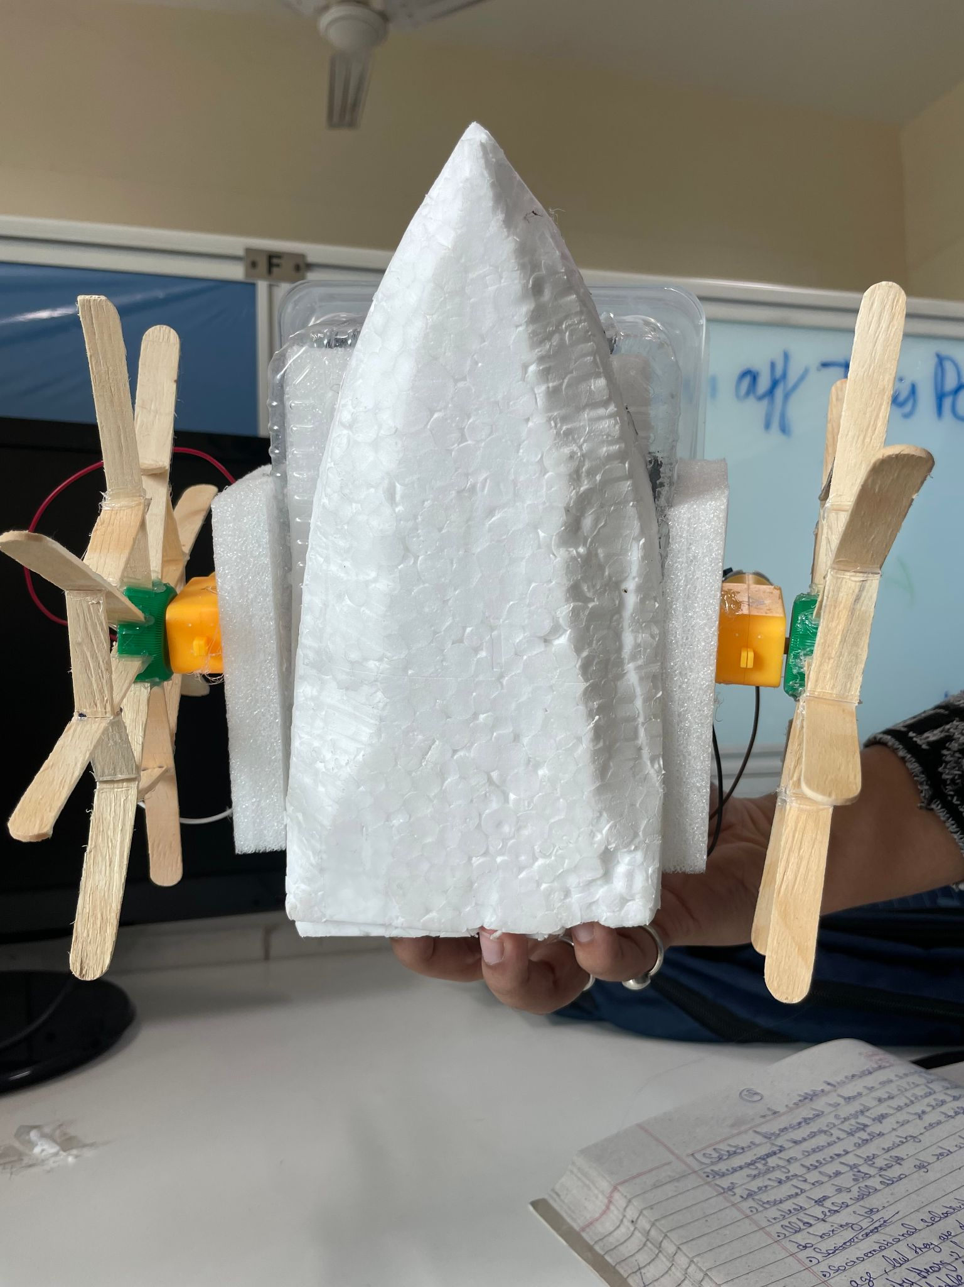
Boat Structure
This is the upside down view of the modified boat structure.
This is lightweight and works better in real-life scenario.
The bottles were removed.
This boat structure was able to remain afloat while carrying all the equipments as well.

Slide 17
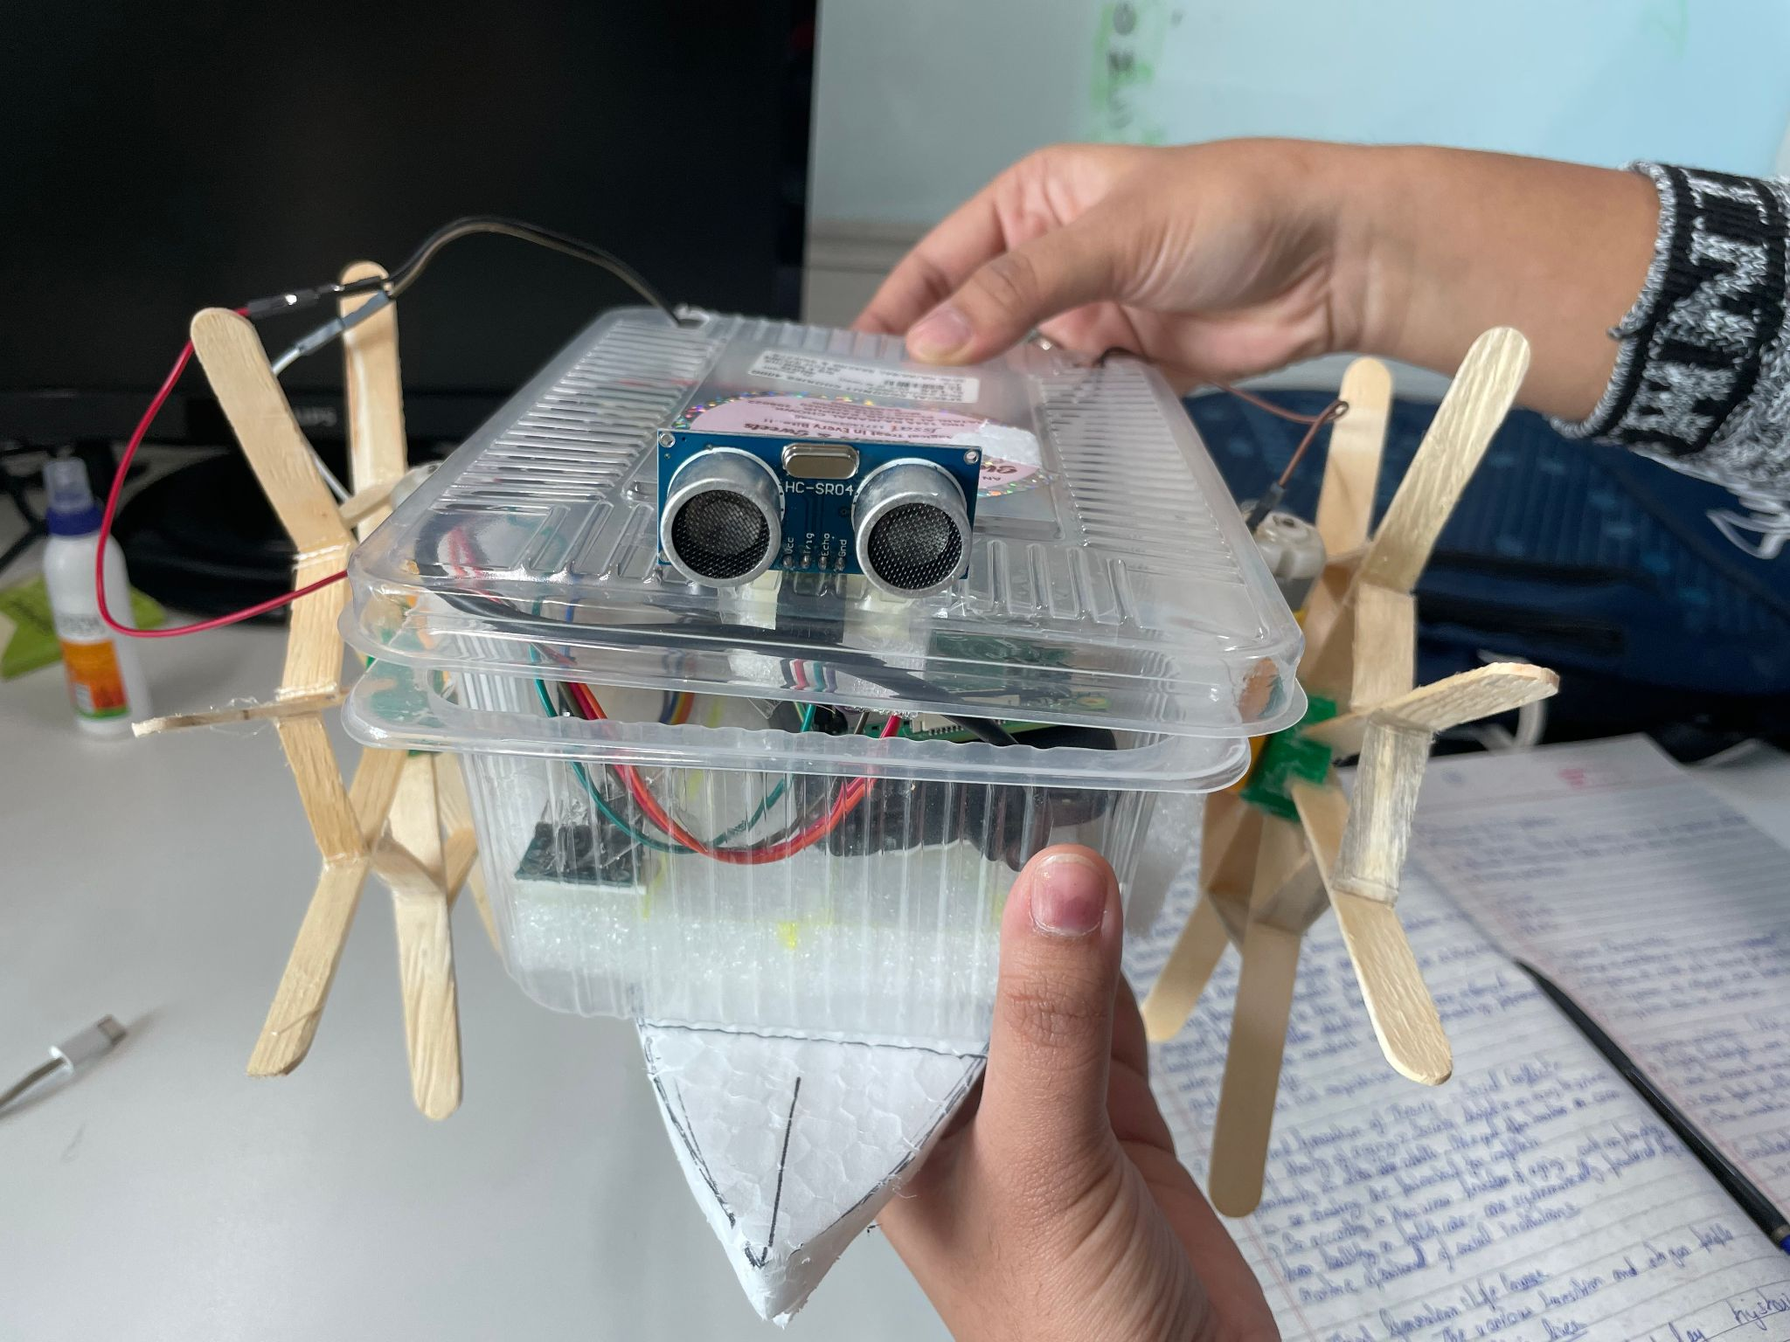
Boat Structure - Front view

Slide 18
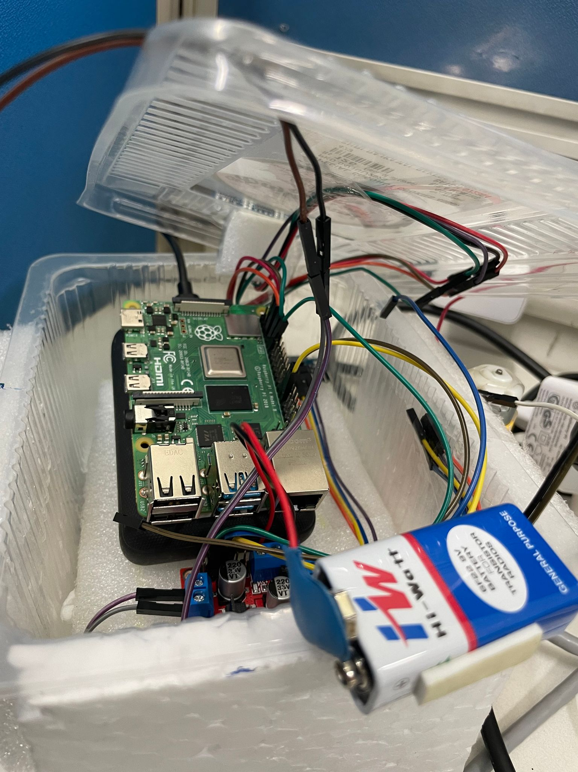
Placement of Equipments inside the boat

Slide 19
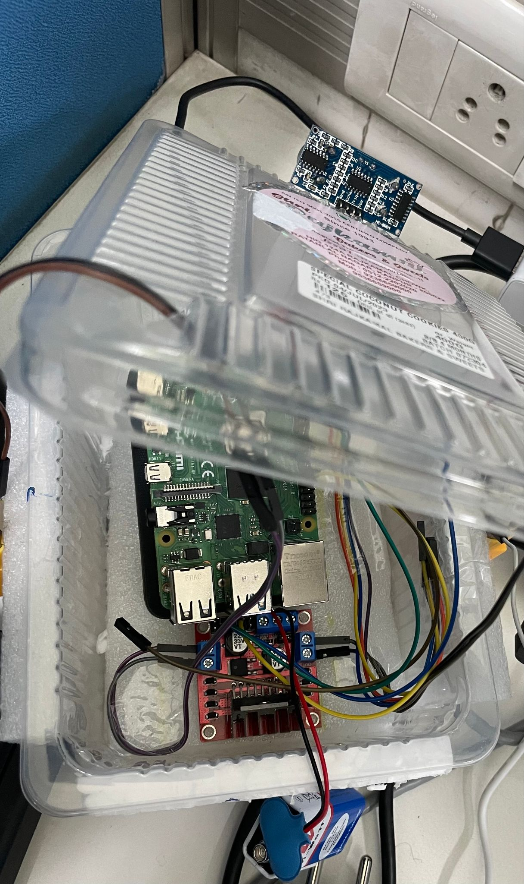
Placement of Equipments inside the boat

Slide 20
05
Demo Video

Slide 21


Slide 22
06
Goals Achieved

Slide 23
Our Goal
Goals Achieved
Goal was to design and develop a Fully Automated Water Pollution Monitor Boat integrated with a Raspberry Pi board and pollution detection sensors for surveillance of water quality in large water bodies including lakes, reservoirs, and canals.
We were able to make a Fully automated Water Pollution Monitor Boat using Raspberry Pi.
The lawnmower movement of the boat was also achieved successfully.
IMU sensor data can be captured to get the local positioning of the boat.
Future Scope
We were not able to integrate the water pollution measurement sensors due to the absence of ADC converter.
This can be done to get the real-time data for pollution detection in water bodies.

Slide 24
Thanks!
Do you have any questions?
Presenters -
Somesh vas (22111056) Divyaksh Shukla(231110603)
Shrutika Jadhav (22111082) Harsh Meena(200416)
Ashee Jain (22111073) Praveen Singh(200721)
Kriti Majumdar(22111404)

